Slide 1
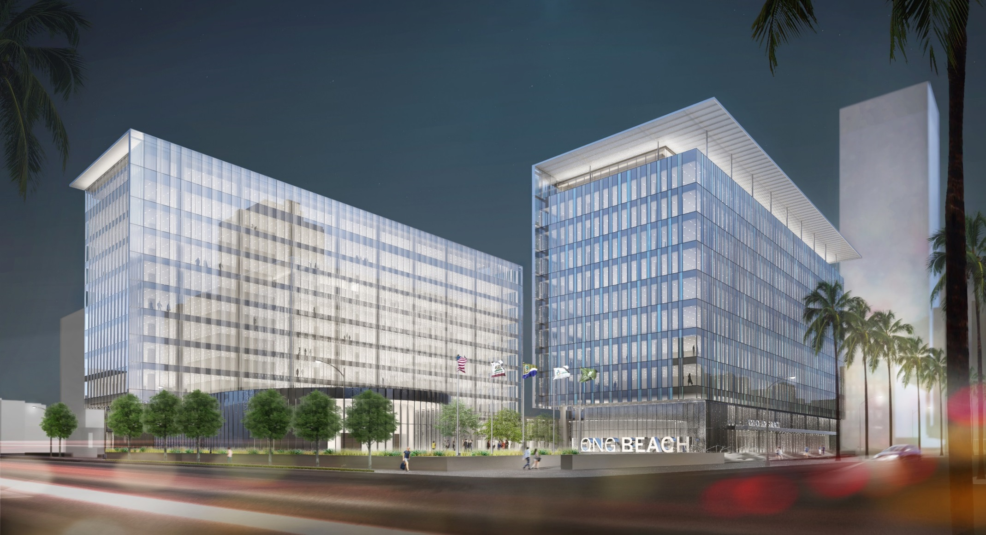

What can I now do with FEMA P-58?
New Design: Long Beach Civic Center (City & Port of Long Beach)
Figure Source: SOM/NYASE 2016 SEAOC presentation

Slide 2
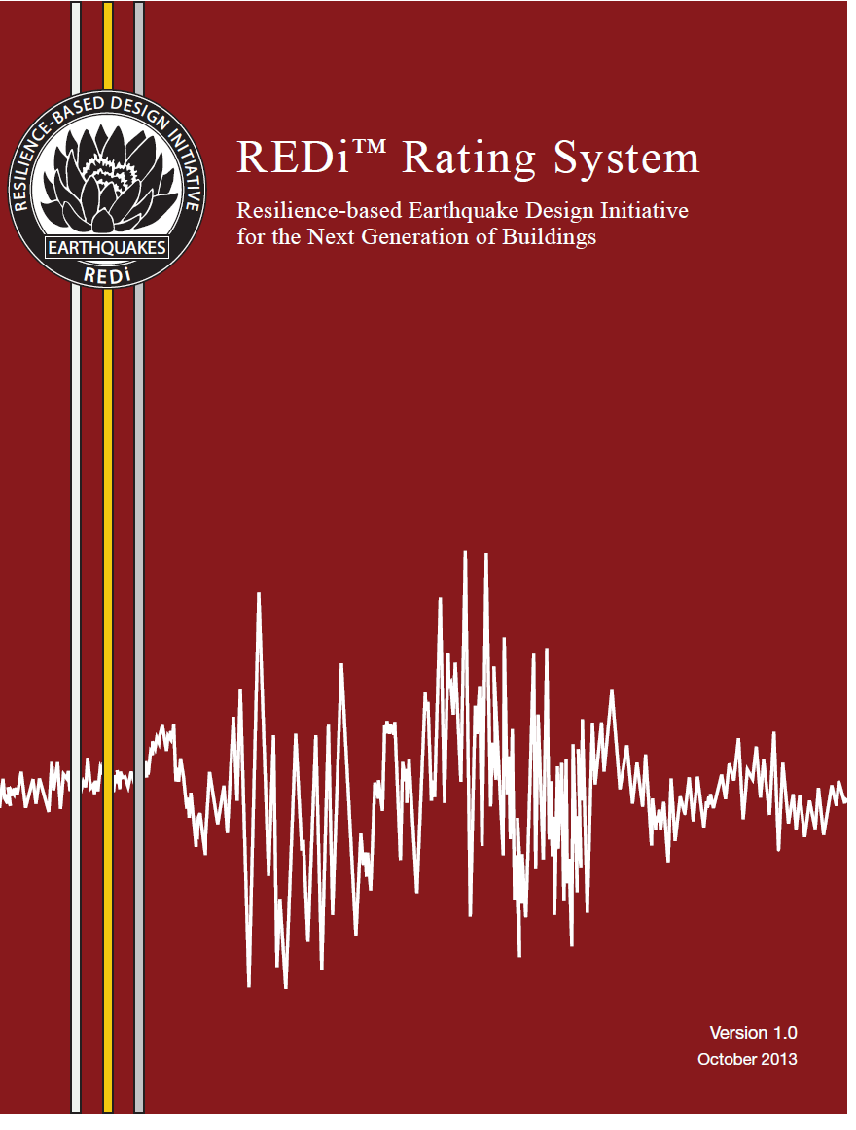
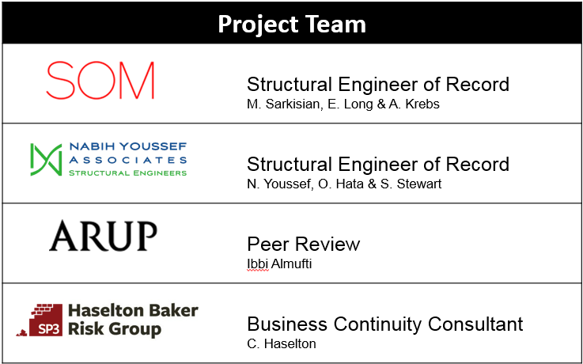
What can I now do with FEMA P-58?
New Design: Long Beach Civic Center (City & Port of Long Beach)
Figure Source: SOM/NYASE 2016 SEAOC presentation

Slide 3
What can I now do with FEMA P-58?
New Design: Long Beach Civic Center (City & Port of Long Beach)
Design Objectives (for design earthquake):
Safe (few or no injuries)
Minimal repair cost (>5%)
Minimal reoccupancy time (>1 week)
Minimal functionality time (>1 month)
REDi: ~Gold Performance
USRC: 4-5 Star Performance
Figure Source: SOM/NYASE 2016 SEAOC presentation

